Slide 1

Battle of the Neighborhoods: Toronto
Applied Data Science Capstone
Jonathan Donnelly
May 2, 2021

Slide 2

Business Problem
Determine the best locations within the city of Toronto to open a sandwich shop.
Utilize data science techniques to identify the best locations within the city of Toronto

Slide 3
Data
Venue details fetched through FourSquare API:
Classifications, Names, Coordinates
List of Toronto Boroughs, Neighborhoods, and Postal Codes for each scraped from Wikipedia
https://en.wikipedia.org/wiki/List_of_postal_codes_of_Canada:_M
List of Toronto Postal Codes and associated geographical coordinates for each.
https://cocl.us/Geospatial_data
2016 Census data on Toronto population
https://open.toronto.ca/dataset/neighbourhood-profiles/

Slide 4
Methodology:
Utilize webscraping to prepare dataframe with Toronto boroughs, neighborhoods, and postal codes.
Read CSV files to create dataframes with coordinates, income, and population.
Request venue data from FourSquare API for venue classifications, locations, and names
Clean all data and create visualizations for ease of understanding and communication
Bar charts using Matplotlib
Maps using Folium

Slide 5
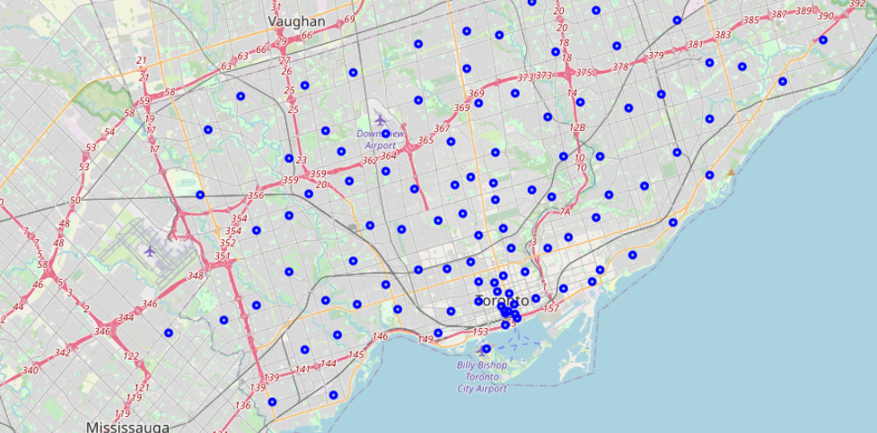
Results
Toronto has 15 boroughs and 140 neighborhoods
The Central Bay Street neighborhood holds the most sandwich shops while 11 only have 1 each.
These 11 are used as potentials for further analysis of population and income.

Slide 6
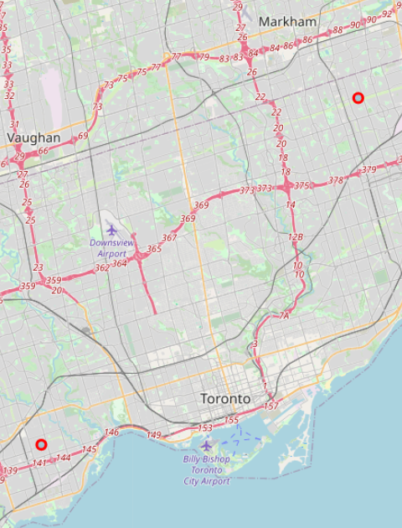
Discussion
Analysis identified two neighborhoods that meet the needs of a small business owner who is seeking to open a sandwich shop
Mimico
Steeles
Both neighborhoods have a demonstrated interest in this type of venue, while not being oversaturated.
Additionally, each neighborhood had a significant population to grow a customer base and where a large portion of the population had an income greater than $100k.

Slide 7
Conclusion
The two neighborhoods identified would both serve as suitable hosts to a newly opened sandwich shop. Potential exists for the small business owner to utilize both as locations for expansion. These neighborhoods are located on opposite sides of the city and would be out of range to compete.
Further analysis is possible to identify size of households and income. Depending on plans for business potential to target neighborhoods with larger disposable income or higher number of families.

